Slide 1

Wi-Fi Detector/Jammer
Omkar Kabde
01
160122749058
Robotics & Drones Lab – Final Project
Under the guidance of
Smt. Venkata Sushma Chinta
Asst Professor
Mechanical Eng. Department
02
Mohammed Imaduddin
160122749053
03
Mahesh Bhat
160122749049
04
Abdul Wasae
160122749027

Slide 2




Contents
01
Abstract & Introduction
02
NodeMCU, IIC and Required Components
03
04
Sketch (Code)
Circuit Design
05
Benefits to Society
06
Literature review & References

Slide 3
Abstract
This project aims to detect Wi-Fi networks in the nearby range. It then displays the networks detected and their strength on a LCD screen. It can also attempt to block/jam them by performing deauthentication attacks using the NodeMCU ESP8266 module.
This project provides an introduction to WiFi Networking and demonstrates the practical implementation of such scans and attacks using readily available hardware and software.
This project serves as a comprehensive introduction to the concept of WiFi deauthentication attacks, which involve the intentional interference with the normal operation of wireless networks. By utilizing this device, users can gain a deeper understanding of the mechanisms and potential impact of such attacks.

Slide 4
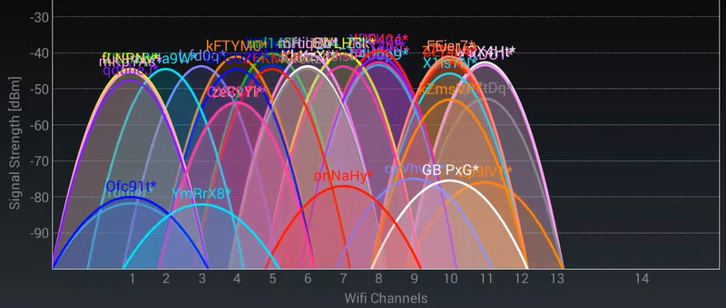
Introduction
Wi-Fi or Wireless Fidelity, uses radio frequencies to send signals between devices. This frequency happens to be 2.4Ghz and 5Ghz. In order to find all available networks, the client needs to go through all possible Wi-Fi channels (radio frequencies), send probe requests, and collect probe responses and beacons that it receives.
The wireless network is has three essential elements that are radio signals, antenna, and router.

Slide 5
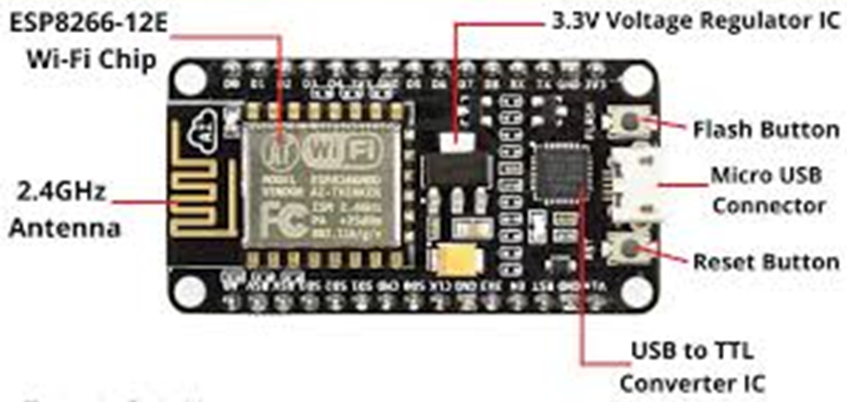
NodeMCU
NodeMCU ESP8266
NodeMCU is an open-source development board that combines the functionality of an ESP8266 Wi-Fi module with a microcontroller, making it easier to create Internet of Things (IoT) projects. The ESP8266 is a popular low-cost Wi-Fi module that enables devices to connect to the internet wirelessly. It provides built-in Wi-Fi connectivity and can be programmed using the Lua scripting language or the Arduino IDE.

Slide 6
IIC
Inter Integrated Circuit
The I2C display interface is a common communication protocol for character, graphic, and segment LCDs. This interface is typically used for sending initialization commands and data to the display controller. The interface is not used for high-speed graphics data. The two required communication signals are SDA and SCL. The SDA pin is used to send and receive data. The SCL signal is used as the clock.
Other Communication Protocols –
UART - Universal Asynchronous Reception and Transmission
SPI - Serial Peripheral Interface

Slide 7
Wi-Fi Scanner
1. Scan Channels: Wi-Fi operates on various channels in the 2.4 GHz and 5 GHz frequency bands. The scanning process typically involves cycling through these channels one by one to detect Wi-Fi signals on each frequency.
2. Probe Requests and Responses: When a Wi-Fi access point is turned on, it periodically broadcasts a "beacon" frame to announce its presence and provide information about the network. During the scan, the Wi-Fi device may also send out "probe requests" on each channel, asking nearby access points to identify themselves. The access points respond with "probe responses," providing details about the network, including SSID and signal strength.
3. Collect Network Information: As the device listens for beacon frames and receives probe responses, it gathers information about nearby networks. This information is then used to build a list of available networks along with their associated data.
4. RSSI Measurement: The Received Signal Strength Indicator (RSSI) is a measure of the power level of the received Wi-Fi signal. The device records the RSSI value for each detected network, which gives an indication of how strong the signal is and how far away the access point is from the scanning device.

Slide 8
Wi-Fi Jammer
1. A Jammer sends noise signals to the Wi-Fi spectrum (2.4GHz) thus disturbing original Wi-Fi frequency spectrum.
2. A Deauther sends packets to interfere with your Wi-Fi signals thus disrupting the normal working of your Wi-Fi router. It behaves like a jammer.
A de-authentication (deauth) attack is a denial of service attack that blocks the communication between a client and an Access Point (AP).
Example for Deauthentication –
When you don’t want a certain device to connect to your Wi-Fi network, You add that device to a Blocklist when you add them to the blocklist a deauthentication packet is received and the station will disconnect from the Wireless Access Point. Because of the way IEEE 802.11 is designed a deauthentication frame is a notification, not a request. Thus, the device must comply and deauthenticate from the Access Point.

Slide 9
Wi-Fi Beacons
The NodeMCU has 2 major modes – Station (STA) mode and Access Point (AP) Mode.
When an ESP8266 is set up in station mode (STA), it can connect to an existing Wi-Fi network, and when set up in access point mode (AP), it can create its own Wi-Fi network for other devices to connect to.
When the ESP8266 is configured as an access point (AP), it periodically sends out Wi-Fi beacons to announce the network's presence and provide network-specific details. These beacons are received by nearby Wi-Fi devices, such as smartphones or laptops, allowing them to detect and list the available Wi-Fi networks.
A Wi-Fi beacon is a type of management frame that access points (routers) periodically broadcast to announce their presence and provide important information about the network.
This dual-mode capability makes the ESP8266 a versatile and popular choice for IoT projects that require Wi-Fi connectivity.

Slide 10
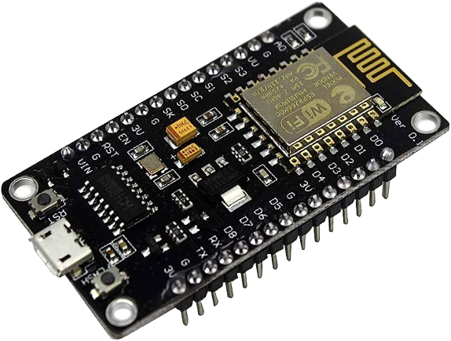
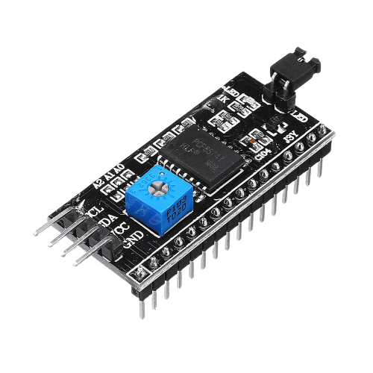
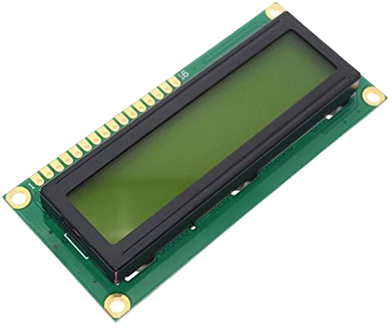
Components Used
ESP8266
i2c module
LCD
To connect and scan for wi-fi networks
Inter-Integrated Circuit
Communication protocol used to connect devices
To display Wi-Fi networks available and their status

Slide 11
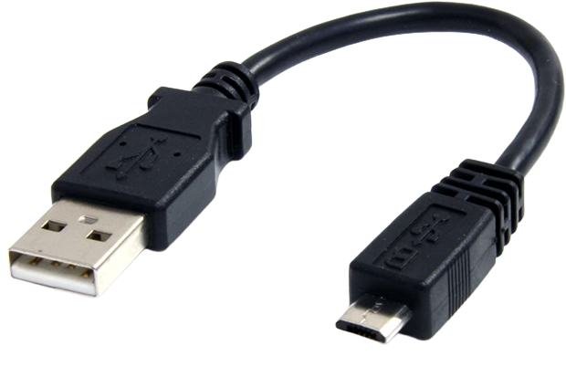
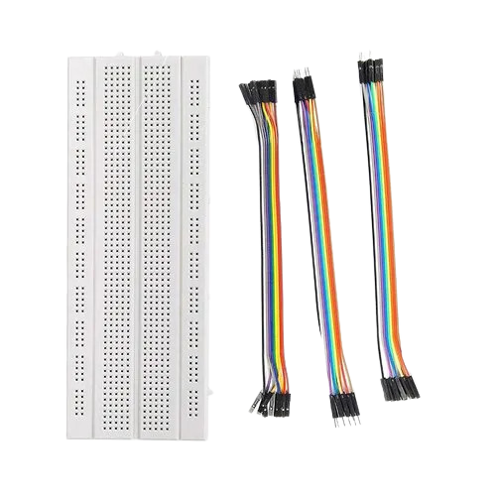

Components Used
USB Cable
Breadboard & jumper wires
Laptop
To connect the NodeMCU and upload the program
Connect and organize electronic components
For power supply

Slide 12
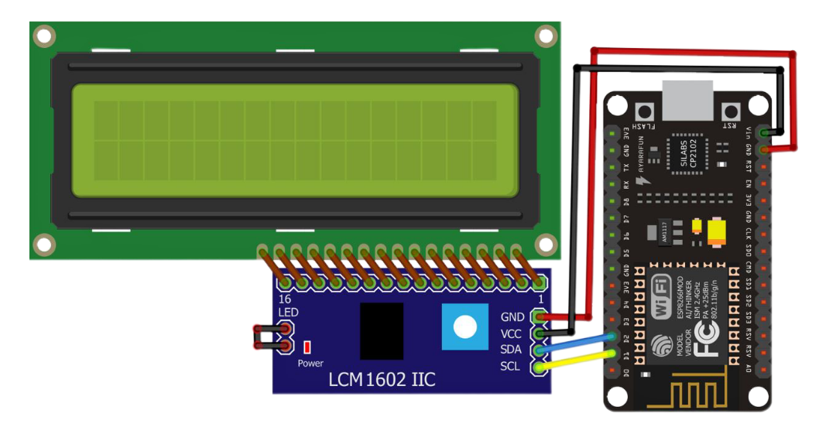
Circuit Design
LCD Display
ESP8266
IIC – ESP – Function
GND – GND – Ground
VCC – Vin – Power Supply
SDA – D2 – Serial Data
Sends and receives data
SCL – D1 – Serial Clock
Clock Signal (synchronization)
i2c module

Slide 13
Code to scan WiFi networks & print them on the LCD display
#include <LiquidCrystal_I2C.h>
#include <ESP8266WiFi.h>
int totalColumns = 16;
int totalRows = 2;
LiquidCrystal_I2C lcd(0x27, totalColumns, totalRows);
void scrollMessage(int row, String message, int delayTime, int totalColumns) {
for (int i=0; i < totalColumns; i++) {
message = " " + message;
}
message = message + " ";
for (int position = 0; position < message.length(); position++) {
lcd.setCursor(0, row);
lcd.print(message.substring(position, position + totalColumns));
delay(delayTime);
}
}
int signal_dBM[] = { -100, -99, -98, -97, -96, -95, -94, -93, -92, -91, -90, -89, -88, -87, -86, -85, -84, -83, -82, -81, -80, -79, -78, -77, -76, -75, -74, -73, -72, -71, -70, -69, -68, -67, -66, -65, -64, -63, -62, -61, -60, -59, -58, -57, -56, -55, -54, -53, -52, -51, -50, -49, -48, -47, -46, -45, -44, -43, -42, -41, -40, -39, -38, -37, -36, -35, -34, -33, -32, -31, -30, -29, -28, -27, -26, -25, -24, -23, -22, -21, -20, -19, -18, -17, -16, -15, -14, -13, -12, -11, -10, -9, -8, -7, -6, -5, -4, -3, -2, -1};
int signal_percent[] = {0, 0, 0, 0, 0, 0, 4, 6, 8, 11, 13, 15, 17, 19, 21, 23, 26, 28, 30, 32, 34, 35, 37, 39, 41, 43, 45, 46, 48, 50, 52, 53, 55, 56, 58, 59, 61, 62, 64, 65, 67, 68, 69, 71, 72, 73, 75, 76, 77, 78, 79, 80, 81, 82, 83, 84, 85, 86, 87, 88, 89, 90, 90, 91, 92, 93, 93, 94, 95, 95, 96, 96, 97, 97, 98, 98, 99, 99, 99, 100, 100, 100, 100, 100, 100, 100, 100, 100, 100, 100, 100, 100, 100, 100, 100, 100, 100, 100, 100, 100};
int strength =0;
int percentage =0;

Slide 14
Code
void setup(){
lcd.init();
lcd.backlight();
Serial.begin(115200);
Serial.println("");
// Set WiFi to station mode and disconnect from an AP if it was previously connected
WiFi.mode(WIFI_STA);
WiFi.disconnect(); //ESP has tendency to store old SSID and PASSword and tries to connect
delay(100);
Serial.println("WiFi Network Scan Started");
}
void loop(){
int n = WiFi.scanNetworks();
Serial.println("Scan done");
if (n == 0){
Serial.println("No Networks Found");
lcd.setCursor(0, 0);
lcd.print("No Networks Found");}
else
{
lcd.setCursor(0, 0);
lcd.print(n);
lcd.println(" Networks found");
String message,adder;
message="";

Slide 15
Code
for (int i = 0; i < n; ++i)
{
// Print SSID and RSSI for each network found
// SSID - Servece Set Identifier - Network name
// RSSI - Received Signal Strength Indicator
Serial.print(": ");
Serial.print(i + 1); //Sr. No
Serial.print(" (");
Serial.print(WiFi.SSID(i));
adder=WiFi.SSID(i);
message.concat(adder);
message.concat("---");
strength =WiFi.RSSI(i);
Serial.print(" - ");
for (int x = 0; x < 100; x = x + 1) {
if (signal_dBM[x] == strength) {
// Print the received signal strength in percentage
percentage = signal_percent[x];
Serial.print(percentage);
Serial.print("%");
break;
}
}
Serial.print(") MAC:");
Serial.print(WiFi.BSSIDstr(i));
Serial.println((WiFi.encryptionType(i) == ENC_TYPE_NONE)?" Unsecured":" Secured");
delay(10);
}
scrollMessage(1, message, 300, totalColumns);
}
Serial.println("");
// Wait a bit before starting New scanning again}

Slide 16

Benefits to Society
Network Security Education: The project provides a practical demonstration of the vulnerabilities present in wireless networks, raising awareness about the importance of securing WiFi connections.
Penetration Testing: Security professionals can use this project to test the resilience of their own or their clients' wireless networks against deauthentication attacks, thereby enhancing network security.
Ethical Hacking Research: The project serves as a foundation for further research and exploration of network security techniques, helping researchers and ethical hackers understand the inner workings of deauthentication attacks.
Military and law enforcement: In specific military or law enforcement operations, WiFi jamming might be employed to disrupt enemy communication systems or prevent remote detonation of explosive devices.
Spectrum management: In certain cases, authorized organizations might use jamming in highly regulated environments to ensure compliance with radio spectrum usage rules and prevent unauthorized transmissions.

Slide 17
Literature Review
Smith, J., & Johnson, A. (2018).
Zhang, L., Li, X., Li, Q., & Wang, H. (2019)
Bharti, P., & Sharma, D. (2020)
Understanding WiFi Deauthentication Attacks. International Journal of Network Security, 20(4), 726-732.
A Study on WiFi Deauthentication Attacks and Countermeasures. In 2020 International Conference on Recent Innovations in Computing (ICRIC) (pp. 1-6). IEEE.
Security Evaluation of WiFi Deauthentication Attacks and Countermeasures. IEEE Access, 7, 10185-10193.
Patel, V., & Raval, M. (2017)
Nidhra, V. M., & Kulkarni, S. V. (2019).
WiFi Deauthentication Attack on 802.11 Networks: A Review. International Journal of Innovative Research in Computer and Communication Engineering, 5(1), 458-464.
WiFi Deauthentication Attack: Detection and Prevention. In 2019 IEEE International Conference on Communication and Signal Processing

Slide 18
References
https://github.com/SpacehuhnTech/esp8266_deauther
https://electronicslovers.com/2019/01/a-simple-homemade-wi-fi-jammer-by-using-an-esp8266-diy-project.html
https://deauther.com/
https://circuitdigest.com/microcontroller-projects/diy-wifi-jammer-using-nodemcu-esp12
https://www.electronicwings.com/arduino/esp8266-wifi-module-interfacing-with-arduino-uno
I2C Tutorial for Arduino, ESP8266 and ESP32 (diyi0t.com)

Slide 19
Conclusion
The WiFi Deauther project utilizing the NodeMCU ESP8266 provides a practical demonstration of WiFi deauthentication attacks. By understanding the vulnerabilities in wireless networks, individuals can take appropriate measures to secure their networks and prevent unauthorized access. The project has implications for network security education, penetration testing, and ethical hacking research.
In conclusion, the WiFi Deauther project using the NodeMCU ESP8266 has multifaceted implications. From enhancing network security education to aiding penetration testing and ethical hacking research, this project serves as an important stepping stone towards a more secure and resilient wireless communication environment. By raising awareness of the risks and vulnerabilities associated with WiFi networks, individuals and organizations can take proactive measures to safeguard their data and systems from potential security breaches.

Slide 20
Thank You
.

